Slide 1



Junior Interface Developer
Modulo 01 - Visual Studio, .NET Framework e C#
Da Lunedì 19/09/2016 a Lunedì 26/09/2016
Gabriele Gaggi

Slide 2
Parte 6 - Database relazionali
Che cos’è un database relazionale
Utilizzare il .NET Framework con SQL Server
Connessione al database ed altri oggetti .NET per lavorare sul database
Definizione di ORM (Object Relation Mapping)
Utilizzare il .NET Framework con Entity Framework
Interrogare i dati con LINQ
Contesto sul database, code-first, migration

Slide 3
RDBMS
R Relational DB Database M Management S System
A RDBMS is a database engine/system based on the relation model specified in 1970
It’s based on tables, columns, records, indexes, primary and foreign keys

Slide 4
RDBMS
It’s based on SQL (Structured Query Language)
SQL is a standard computer language for relational database management and data manipulation
SQL is used to query, insert, update, modify and delete data

Slide 5
RDBMS
SQL code is divided into:
DML = Data Manipulation Language
DDL = Data Definition Language
DCL = Data Control Language

Slide 6
SQL Server
The RDBMS developed by Microsoft is SQL Server
SQL Server Express is available for free
SQL Server database is accessible from any application using the .NET Framework

Slide 7
SQL Server
.NET Framework supports three scenarios:
Disconnected
Connected
Entity Framework

Slide 8
Lesson: ADO.NET Architecture
What Is ADO.NET?
What Is a Connected Environment?
What Is a Disconnected Environment?
What Is the ADO.NET Object Model?
What Is the DataSet Class?
What Is the .NET Data Provider?

Slide 9
What Is ADO.NET?
ADO.NET is a data access technology. It provides:
A set of classes, interfaces, structures, and enumerations that manage data access from within the .NET Framework
An evolutionary, more flexible successor to ADO
A system designed for disconnected environments
A programming model with advanced XML support

Slide 10
What Is a Connected Environment?
A connected environment is one in which users are constantly connected to a data source
Advantages:
Environment is easier to secure
Concurrency is more easily controlled
Data is more likely to be current than in other scenarios
Disadvantages:
Must have a constant network connection
Scalability

Slide 11
What Is a Disconnected Environment?
In a disconnected environment, a subset of data from a central data store can be copied and modified independently, and the changes merged back into the central data store
Advantages
You can work at any time that is convenient for you, and can connect to a data source at any time to process requests
Other users can use the connection
A disconnected environment improves the scalability and performance of applications
Disadvantages
Data is not always up to date
Change conflicts can occur and must be resolved

Slide 12
What Is the ADO.NET Object Model?
DataSet
.NET Data Provider
DataTableCollection
Connection
DataAdapter
DataTable
Transaction
SelectCommand
DataRowCollection
Command
InsertCommand
DataColumnCollection
Parameters
UpdateCommand
ConstraintCollection
DataReader
DeleteCommand
DataRelationCollection
XML
Database

Slide 13
What Is the DataSet Class?
DataSet
DataSets consist of one or more tables and relations
Loaded from one or more data adapters
Created as you work
Loaded from XML
Loaded from other DataSets
Tables contain columns, constraints, and rows
All are collections!
Tables
Table
Columns
Column
Constraints
Constraint
Rows
Row
Relations
Relation
Object
Collection

Slide 14
What Is the .NET Data Provider?
Database
Manages the connection to a database
Connection
Executes a query command on the database
Command
Exchanges data between the data set and the database
DataAdapter
Provides efficient access to a stream of read-only data
DataReader

Slide 15
Lesson: Creating an Application That Uses ADO.NET to Access Data
How to Specify the Database Connection
How to Specify the Database Command
How to Create the DataAdapter Object
How to Create a DataSet Object
How to Bind a DataSet to a DataGrid
How to Use the Data Wizards in Visual Studio .NET

Slide 16
How to Specify the Database Connection
Use the Connection object to:
Choose the connection type
Specify the data source
Open the connection to the data source
Use the connection string to specify all of the options for your connection to the database, including the account name, database server, and database name
string connectionStr = @"Data Source=localhost; Integrated Security=SSPI; Initial Catalog=northwind";

Slide 17
How to Specify the Database Command
string commandStr=@"SELECT CustomerName, CompanyName FROM Customers";
Create a string containing SQL statements
Remember that Verbatim strings can make this much easier!
Examples of SQL statements:
SELECT * FROM Customers
SELECT CustomerName FROM Customers
SELECT * FROM Customers WHERE Country = 'Mexico'

Slide 18
How to Create the DataAdapter Object
DataSet
DataAdapter
Data source
DataTable
Fill
Update
DataAdapter
DataTable
Fill
Update

Slide 19
How to Create a DataSet Object
DataSet
Use Fill method of DataAdapter
Populate programmatically by creating a table structure and filling it
Read an XML document or stream into a DataSet
Use Merge method to copy the contents of another DataSet object
Tables
Table
Columns
Column
Constraints
Constraint
Rows
Row
Relations
Relation
Object
Collection

Slide 20
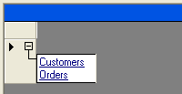
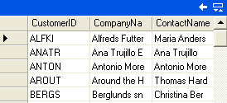
How to Bind a DataSet to a DataGrid
To bind programmatically
DataGrid dataGrid1 = new DataGrid();
sqlDataAdapter1.Fill(dataSet1, "Customers");
sqlDataAdapter2.Fill(dataSet1, "Orders");
dataGrid1.DataSource = dataSet1;

Slide 21
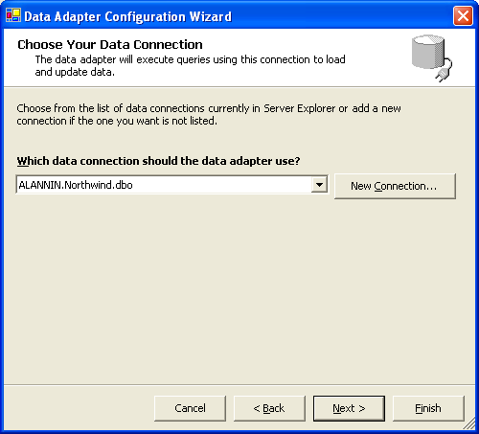
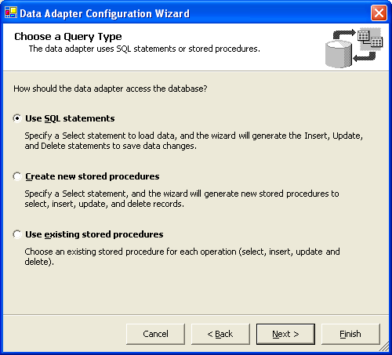
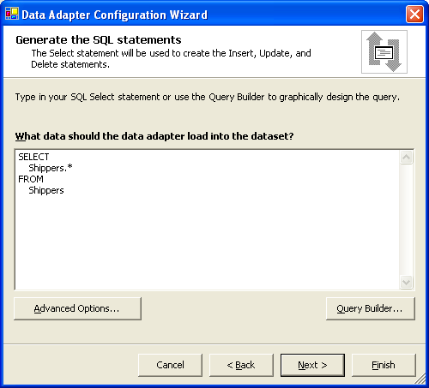
How to Use the Data Wizards in Visual Studio .NET

Slide 22
Lesson: Changing Database Records
How to Access Data in a DataSet Object
How to Update a Database in ADO.NET
How to Create a Database Record
How to Update a Database Record
How to Delete a Database Record

Slide 23
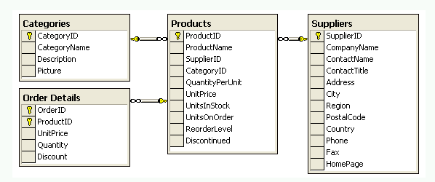
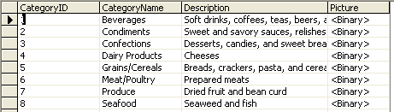
How to Access Data in a DataSet Object
DataRow objects
DataTable
objects
DataColumn objects
DataColumn objects

Slide 24
How to Update a Database in ADO.NET
Client
Server
DataSet
DataAdapter
Database
Fill
Data
Data
Update
DataTable
InsertCommand
UpdateCommand
DeleteCommand

Slide 25
How to Create a Database Record
Create a new row that matches the table schema
Add the new row to the dataset
Update the database
DataRow myRow = dataTable.NewRow();
dataTable.Rows.Add( myRow );
sqlDataAdapter1.Update( dataSet );

Slide 26
How to Update a Database Record
1
Modify the row containing the record
2
Generate a new dataset containing the changes
3
Check the new dataset for errors
4
Merge the changes back into the original dataset
5
Call the Update method on the data adapter
6
Call the AcceptChanges method on your original dataset

Slide 27
How to Delete a Database Record
Delete the row from the dataset
Update the database
Accept the changes to the dataset
dataTable.Rows[0].Delete();
dataAdapter.Update(dataSet);
dataSet.AcceptChanges();

Slide 28
Entity Framework
Entity Framework is the ORM developed by Microsoft
ORM = Object/Relation Mapping

Slide 29
Entity Framework
The Microsoft ADO.NET Entity Framework is an ORM framework that enables developers to work with relational data as domain-specific objects, eliminating the need for most of the data access plumbing code that developers usually need to write
Using the Entity Framework, developers issue queries using LINQ, then retrieve and manipulate data as strongly typed objects
The Entity Framework's ORM implementation provides services like change tracking, identity resolution, lazy loading, and query translation so that developers can focus on their application-specific business logic rather than the data access fundamentals.

Slide 30
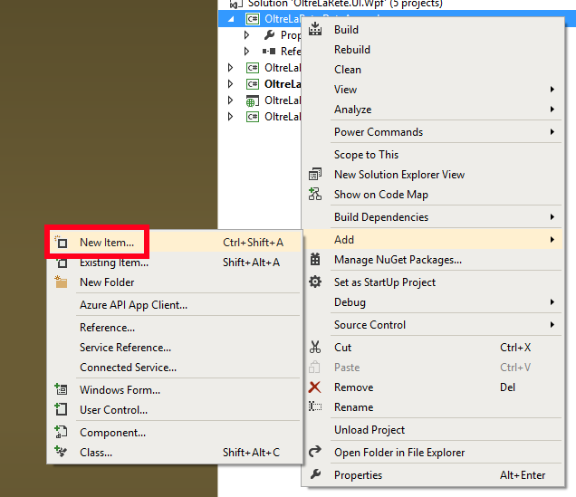
Entity Framework
You can add a Entity Framework data model from Visual Studio

Slide 31
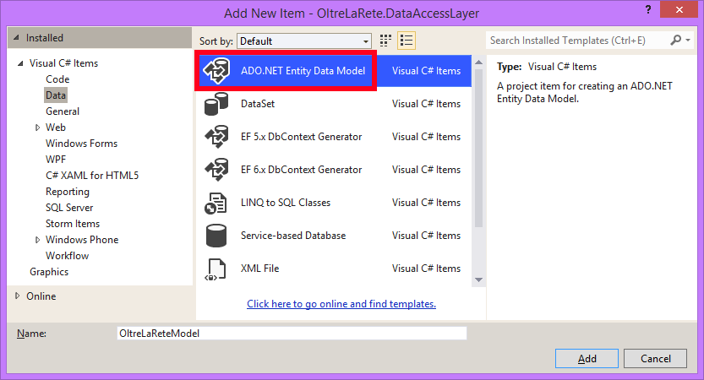
Entity Framework

Slide 32
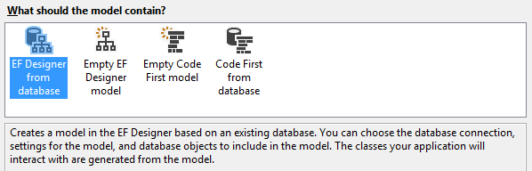
Entity Framework
You can choose between 4 different strategies to connect your domain model and database

Slide 33
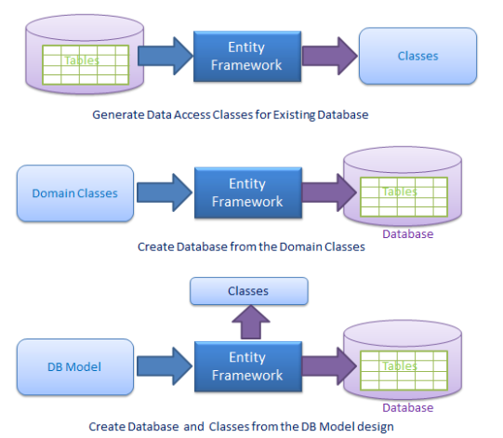
Entity Framework

Slide 34
Entity Framework
EF Designer from database Creates a model in the EF Designer based on an existing database. You can choose the database connection, settings for the model, and database objects to include in the model. The classes your application will interact with are generated from the model
Empty EF Designer model Creates an empty model in the EF Designer as a starting point for visually designing your model. Later, you can generate a database from your model. The classes your application will interact with are generated from the model

Slide 35
Entity Framework
Empty Code First model Creates an empty Code First model as a starting point for designing your model using code. Later, you can generate a database from your model
Code First from database Creates a Code First model based on an existing database. You can choose the database connection, settings for the model, and database objects to include in the model

Slide 36
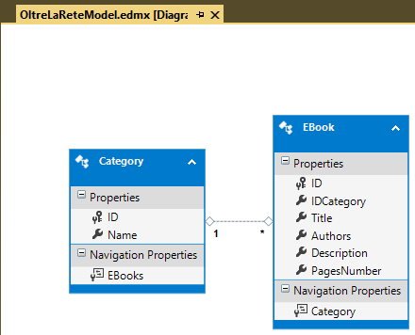
Entity Framework

Slide 37
Entity Framework
Using Entity Framework, you can query and manipulate data using LINQ (Language INtegrated Query)
OltreLaReteEntities ctx = new OltreLaReteEntities();
var book = ctx.EBooks.Where (b => b.ID == 3).FirstOrDefault();
Console.WriteLine(book.Title);
Console.ReadKey();
ctx.Dispose();

Slide 38
Entity Framework
Using Entity Framework, you can query and manipulate data using LINQ (Language INtegrated Query)
OltreLaReteEntities ctx = new OltreLaReteEntities();
var book = new EBook()
{
Title = "title",
Authors = "author",
PagesNumber = 114,
Description = "short trama"
};
ctx.EBooks.Add(book);
ctx.SaveChanges();
ctx.Dispose();

Slide 39
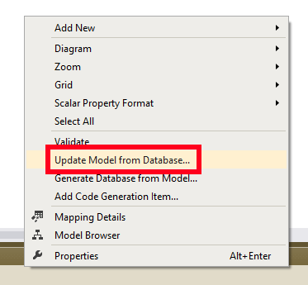
Entity Framework
You can update your model based on database schema
You can add / refresh / delete any database objects

Slide 40
Entity Framework
Using Entity Framework you can consume: tables views stored procedures

Slide 41
Entity Framework
The best approach with Entity Framework is the code-first
You create the database schema based on the model
Enabling migrations, you can maintain the database schema according to your model

Slide 42
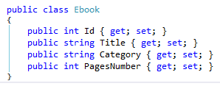
Entity Framework
First Step : write your domain class

Slide 43
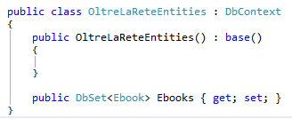
Entity Framework
Second Step : write the EF class context

Slide 44
Entity Framework
The application is ready to run
The database is automatically created on .\SQLEXPRESS instance of SQL Server
Tables and columns name are inferred from class and properties name
EF automatically creates primary and foreign key

Slide 45
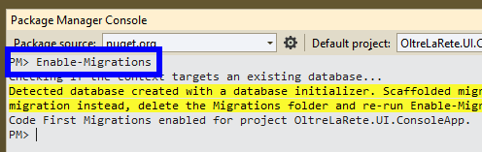
Entity Framework
Third Step : enable migrations

Slide 46
Entity Framework
Now you can update your domain classes
You can add scalar or complex properties

Slide 47
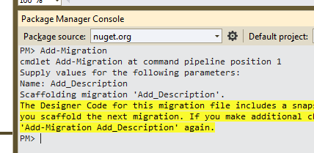
Entity Framework
Fourth Step : add a new migration specifying a name

Slide 48
Entity Framework
A migration is automatically included in the current project
Each migration is a C# class that contains a T-SQL code
Each migration can update the database schema

Slide 49
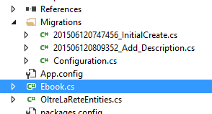
Entity Framework

